Slide 1
BMI and Pregnancy
Healthy mothers healthy Babies
Assist. Lecturer. Alyaa Hussein Ali

Slide 2
What is BMI ?
Body mass index (BMI) , formerly called the Quetelet index, is a measure for indicating nutritional status in adults. It is defined as a person’s weight in kilograms divided by the square of the person’s height in meters (kg/m2.).

Slide 3
The formula to measure the BMI: BMI (kg/m2) = Body weight (kg) / Height (m)2

Slide 4
Although the BMI number is calculated the same way for children and adults, the criteria used to interpret the meaning of the BMI number for children and teens are different from those used for adults.

Slide 5
Why use BMI?
BMI is a simple, inexpensive, and noninvasive surrogate measure of body fat. In contrast to other methods, BMI relies solely on height and weight and with access to the proper equipment, individuals can have their BMI routinely measured and calculated with reasonable accuracy.
Furthermore, studies have shown that BMI levels correlate with body fat and with future health risks. High BMI predicts future morbidity and death. Therefore, BMI is an appropriate measure for screening for obesity and its health risks.

Slide 6
Obesity is defined as having a BMI of 30 or greater.

Slide 7
Obesity and Women’s Health
In the last half century obesity has become an epidemic within the developed world, where it is estimated that over 1.5 billion adults are overweight. Nearly 300 million women are now thought to be clinically obese. Being too fat (adiposity) causes significant health problems not only for individuals but also for families and communities who have to bear the cost of managing the associated medical conditions, often utilizing a major portion of the total health budget . Adiposity has particular consequences for women and for reproductive health.

Slide 8
Pregnancy and BMI
Obesity can cause the following problems for pregnant women:
1. Breathing problems(Obstructive sleep apnea—Sleep apnea is a condition in which a person stops breathing for short periods during sleep. During pregnancy, sleep apnea can cause fatigue and increase the risk of high blood pressure, preeclampsia, and heart and lung problems.

Slide 9
2. Preeclampsia—Preeclampsia is a serious form of gestational hypertension that usually happens in the second half of pregnancy or soon after childbirth. This condition can cause the woman's kidneys and liver to fail. In rare cases, seizures, heart attack, and stroke can happen. Other risks include problems with the placenta and growth problems for the fetus.
3.Gestational diabetes—High levels of glucose (blood sugar) during pregnancy increase the risk of having a very large baby. This also increases the chance of cesarean birth. Women who have had gestational diabetes have a higher risk of diabetes mellitus in the future. So do their children.

Slide 10
4.Deep vein thrombosis
5. Endometritis
6.Postpartum hemorrhage
7.Wound infections
8.Urinary tract infections
9. Prolonged hospitalization associated with delivery complications

Slide 11
10.Affect labor and delivery:Women who are overweight and obese have longer labors than women of normal weight. It can be harder to monitor the fetus during labor. For these reasons, obesity during pregnancy increases the likelihood of having a cesarean birth. If a cesarean birth is needed, the risks of infection, bleeding, and other complications are greater for a woman who is obese than for a woman of normal weight.

Slide 12
The risks for fetal and neonate:
1.Abortion
2.Birth defects:Babies born to women who are obese have an increased risk of having birth defects, such as heart defects and neural tube defects (NTDs)
3.Birth trauma
4.Macrosomia:In this condition, the fetus is larger than normal. This can increase the risk of injury during birth. For example, the fetus’s shoulder can get stuck after the head is delivered. Macrosomia also increases the risk of cesarean birth. Infants born with too much body fat have a greater chance of being obese later in life

Slide 13
5.Preterm birth:birth—Problems associated with a woman’s obesity, such as preeclampsia, may lead to a medically indicated preterm birth. This means that the baby is delivered early for a medical reason. Preterm babies are not as fully developed as babies who are born after 39 weeks of pregnancy. As a result, preterm babies have an increased risk of short-term and long-term health problems.
6.Stillbirth:The higher the woman’s BMI, the greater the risk of stillbirth.

Slide 15
Prepregnancy Management:
Preconception counseling and change lifestyles
-The adverse affect of the obesity on the fertility
-The potential pregnancy complication associated with obesity
-Counseling about the benefit about loss weight before pregnancy
-Use medication as doctor prescribed

Slide 16
3. Bariatric surgery :may be an option for people who are very obese or who have major health problems caused by obesity. If women have weight loss surgery, should delay getting pregnant for 12 to 24 months after surgery, when mother will have the most rapid weight loss.
-Prepregnancy weight lose:
1.To lose weight, we need to use up more calories than take in. the patient can do this by getting regular exercise and eating healthy foods. The obstetrician–gynecologist (ob-gyn) may refer to a nutritionist to help patient plan a healthy diet.

Slide 17
During Pregnancy
1.Exercise in pregnancy that uses upper or lower extremities that don’t increase ut. Contraction If maternal have never exercised before, pregnancy is a great time to start. Discuss exercise plan with ob-gyn to make sure it is safe. Begin with as little as 5 minutes of exercise a day and add 5 minutes each week. The goal is to stay active for 30 minutes on most—preferably all—days of the week.
Walking is a good choice if maternal are new to exercise. Swimming is another good exercise for pregnant women. The water supports weight so women can avoid injury and muscle strain. It also helps mother stay cool.

Slide 18
2. Behavior modification
3.Finding a balance between eating healthy foods and staying at a healthy weight is important for maternal health and fetus's health. In the second and third trimesters, a pregnant woman needs an average of 300 extra calories a day. Maternal can get help with planning a healthy diet by talking to a nutrition counselor
4.Thromboprophlaxis
5.Screening for congenital abnormality
6.Screening for GDM

Slide 19
Postpartum
1.Thrompoprophylaxis
2.Prophylactic antibiotic
3.Mointor for another complication
4. At home with new baby, stick to healthy eating and exercise habits to reach a normal weight. Breastfeeding is recommended for the first year of a baby’s life. Not only is breastfeeding the best way to feed the baby, it also may help with postpartum weight loss. Overall, women who breastfeed their babies for at least a few months tend to lose pregnancy weight faster than women who do not breastfeed.

Slide 20
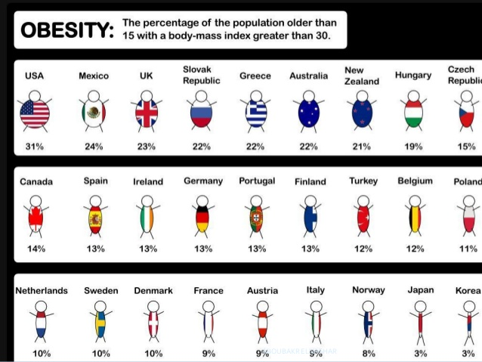

Slide 21
Q/ Patient his weight was 80 kg , and his height was 150 cm, measure the BMI and write what type this result?

